Slide 1
Automated Vendor SLA Tracker
CS 4365
Group 38
Ryan Pham

Slide 2
The Cost of SLA Blindness
Supply chain disruptions occur every 3.7 years
Unchecked delays can compromise up to 40% of profits over a decade
58% of enterprises lack visibility into deeper supplier networks

Slide 3
The Flaw in Traditional Systems
01
02
03
The Flaw
Traditional Batch ETL creates severe data latency
Analyst Toll
Manual dashboard refreshing leads to critical "Dashboard Fatigue."
The Goal
Shift from Passive Reporting to Active Alerting

Slide 4
The Solution
Live Ingestion
Standardization
01
02
Continuous proxy feed via Boston MBTA JSONAPI
UTC timezone tracking & relational SQLite storage
Frontend BI
Backend Alerting
03
04
Live executive dashboards via Power BI (ODBC)
State-aware Python microservice via Slack webhooks

Slide 5
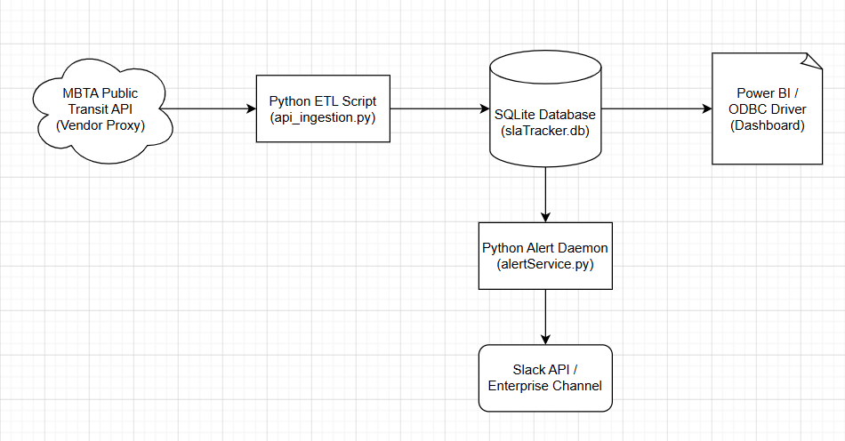
Event-Driven System Architecture

Slide 6
01
Live Demo:
Pipeline Engineering
API Connection & JSON Extraction
UTC Datetime
Transformation Logic

Slide 7
02
Live Demo:
Execution & Alerting
Database Ingestion
Microservice Trigger & Slack Integration

Slide 8
03
Live Demo:
Business Intelligence
ODBC System Bridge
Custom DAX Measures & Executive UI

Slide 9
Evaluation & Performance
Database Load Test
Injected 1,000 concurrent records.
Execution time: 0.03 seconds (Zero database lockouts)
Alert Throttling Validation
15-minute state-aware cooldown.
Successfully throttled duplicate webhooks to prevent alert spam

Slide 10
Meta-Skills
Architectural Pivoting & System Resilience
Managing Enterprise Technical Constraints
Human Centric Design

Slide 11

Future Work
Short Term
True Continuous Monitoring
Long Term
Cloud Migration
Train Predictive Machine Learning Modules

Slide 12
Thank You!

